Slide 1
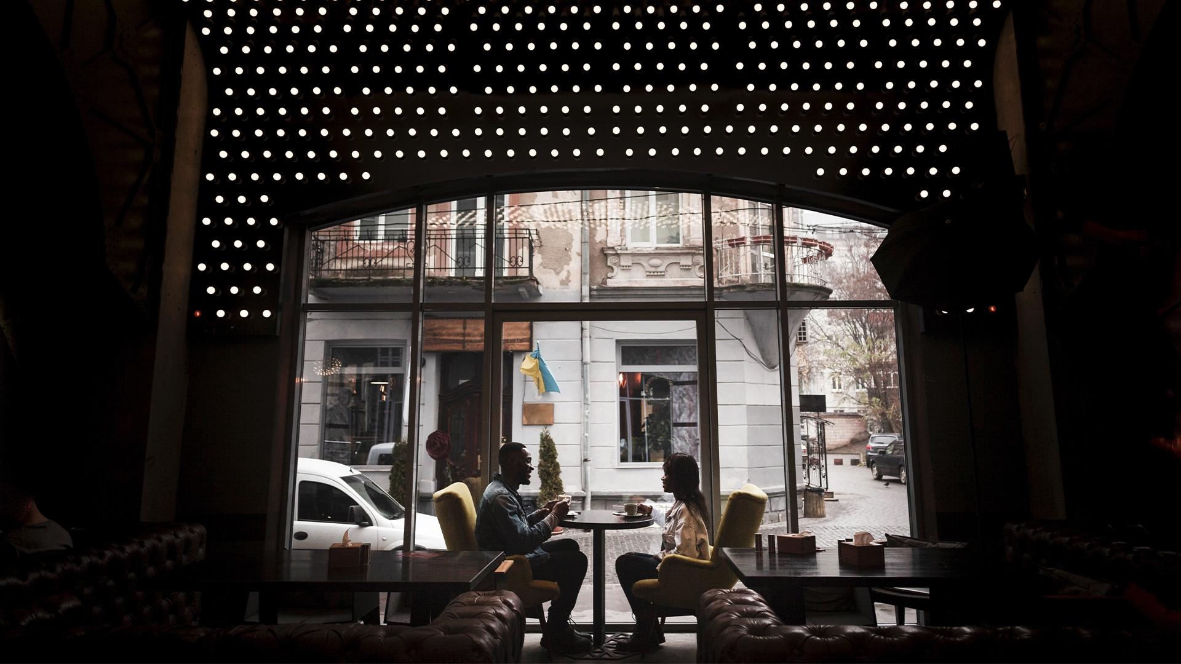


UVAACH KUNAL VERMA 18BCE10150 KARTIKEY NARAIYAN GARG 18BCE10140 YASHRAJ ANAND 18BCE10326 DUSHYANT SENGUPTA 18BCG10042 KRISH GUPTA 18BCE10143 CHITAWN SINGH 18BCE10085 MONISHA BISWAS 18BOE10033 SOUMYA TIWARI 18BCY10100 Under the guidance of Dr. Suthir S

Slide 2
01
Objective
Project Modules
02
03
04
Responsibility of each team member
Technology Used Module Wise
The aim of the project specifying the purpose, motivation of the work.
Explaining the project modules and point wise technology used in each module with Blueprint.
05
Explanation of each technology used in Modules.
The contribution in module wise & Work integration.
Reference

Slide 3

OBJECTIVE
01
The main idea of this project is to somehow reduce the barrier of communication between deaf-dumb and normal people and to guide blind people. To minimize this barrier, the proposed device converts their hand gestures into voice which a normal person can understand.

Slide 4

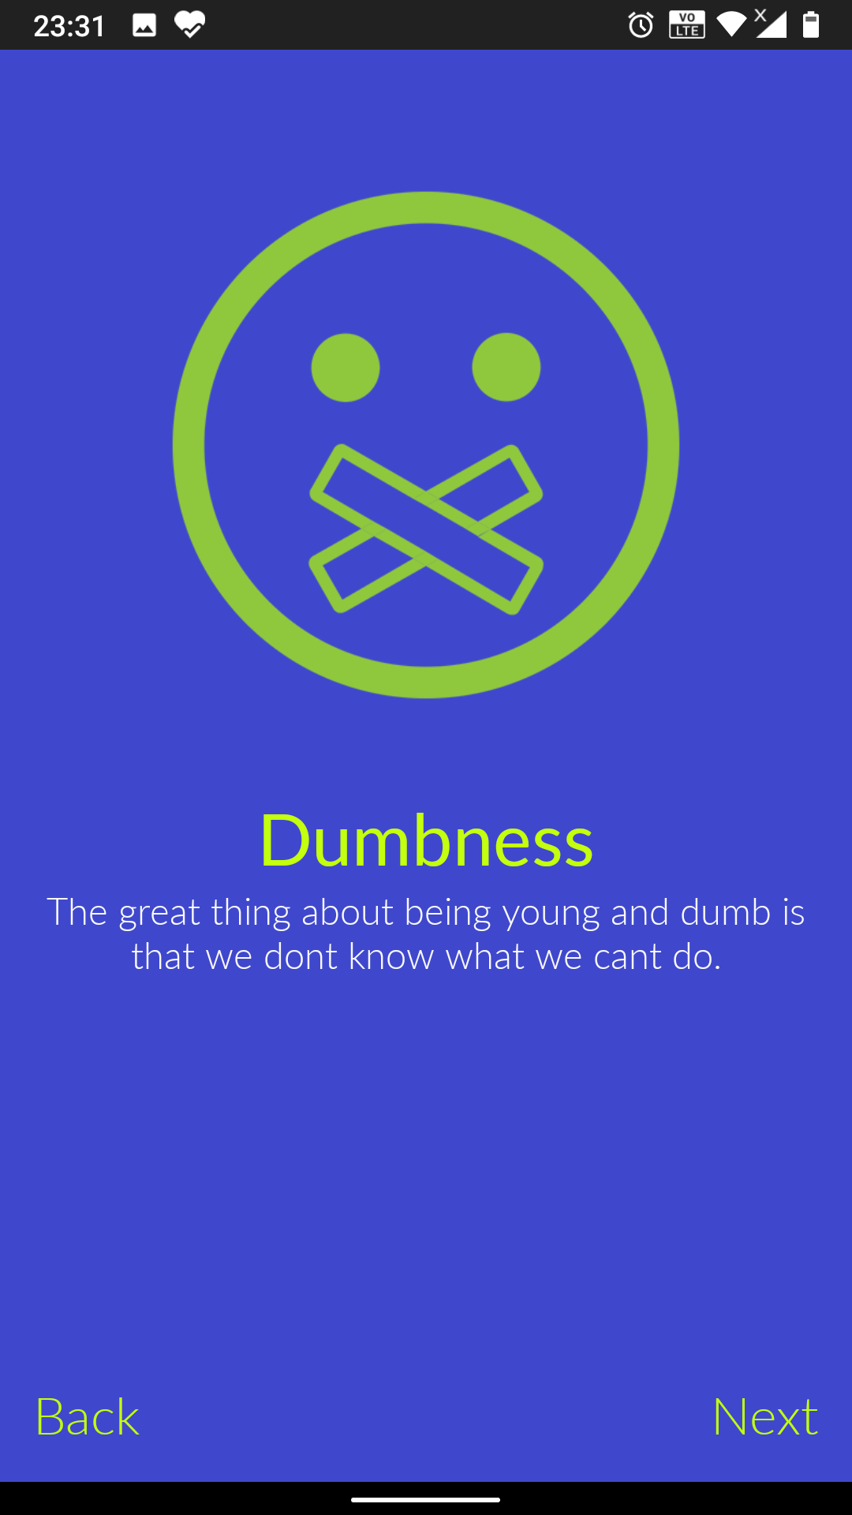
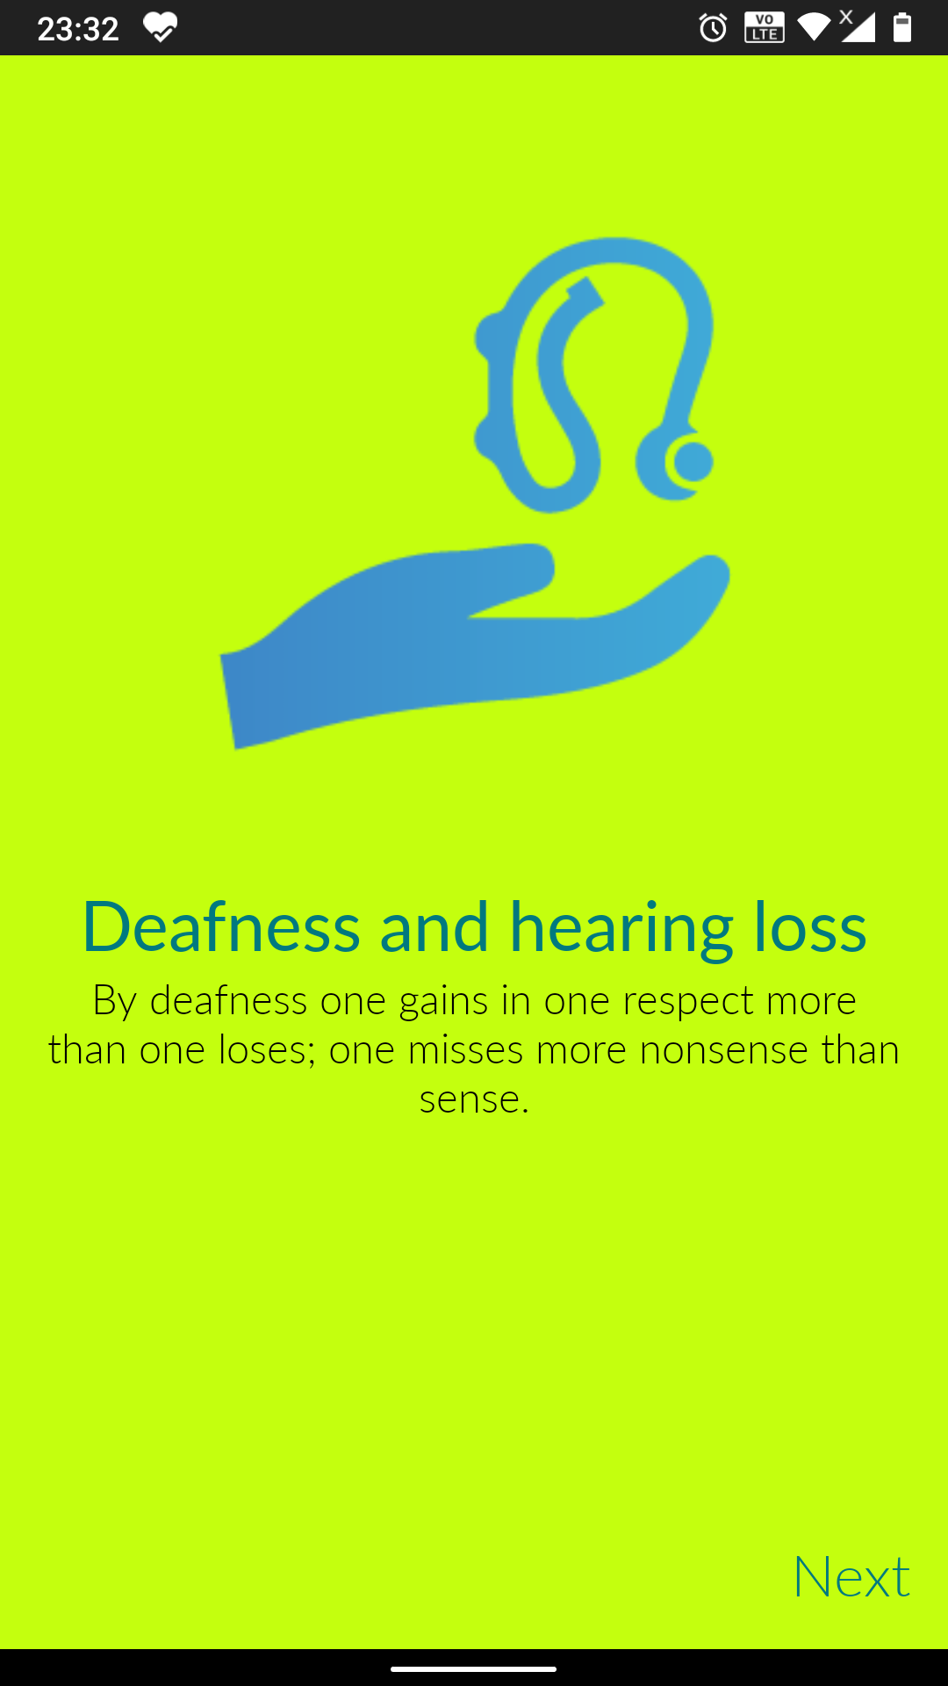
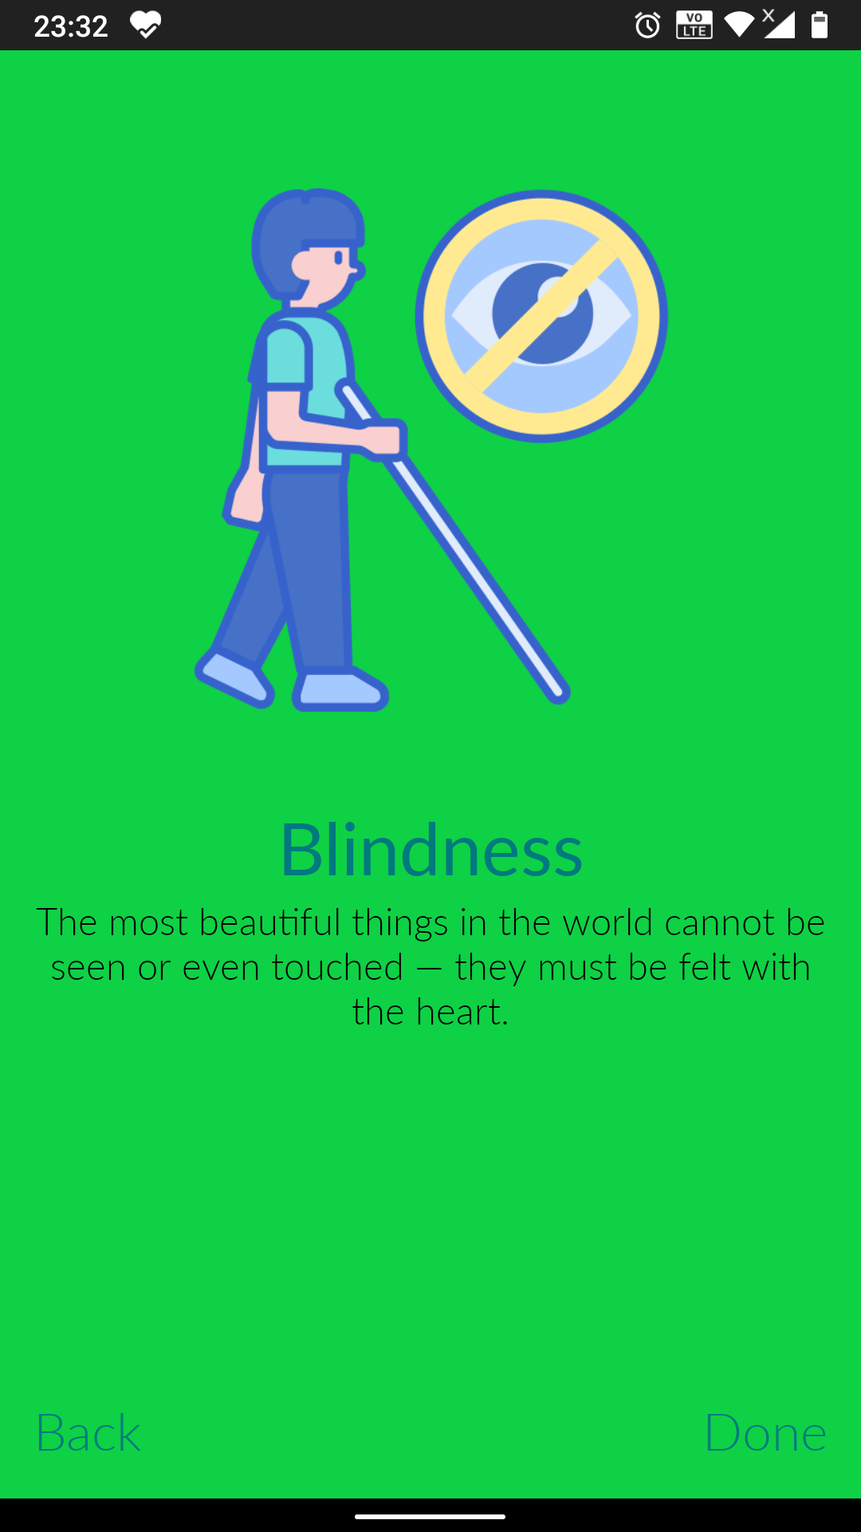
UVVACH
OBJECTIVE
The main idea of this project is to somehow reduce the barrier of communication between deaf-dumb and normal people. To minimize this barrier, the proposed device converts their hand gestures into voice which a normal person can understand.
MOTIVATION OF WORK
Before the commencement of the project, one of our members went to the market and observed the community of deaf, dumb and blind, having difficulties in communicating with the vendors and the vendors having trouble understanding them and he wanted to help them. Thus once we formed our teams for EPICS, he mentioned this incident with us and we decided to create a project to help such people in the community.

Slide 5
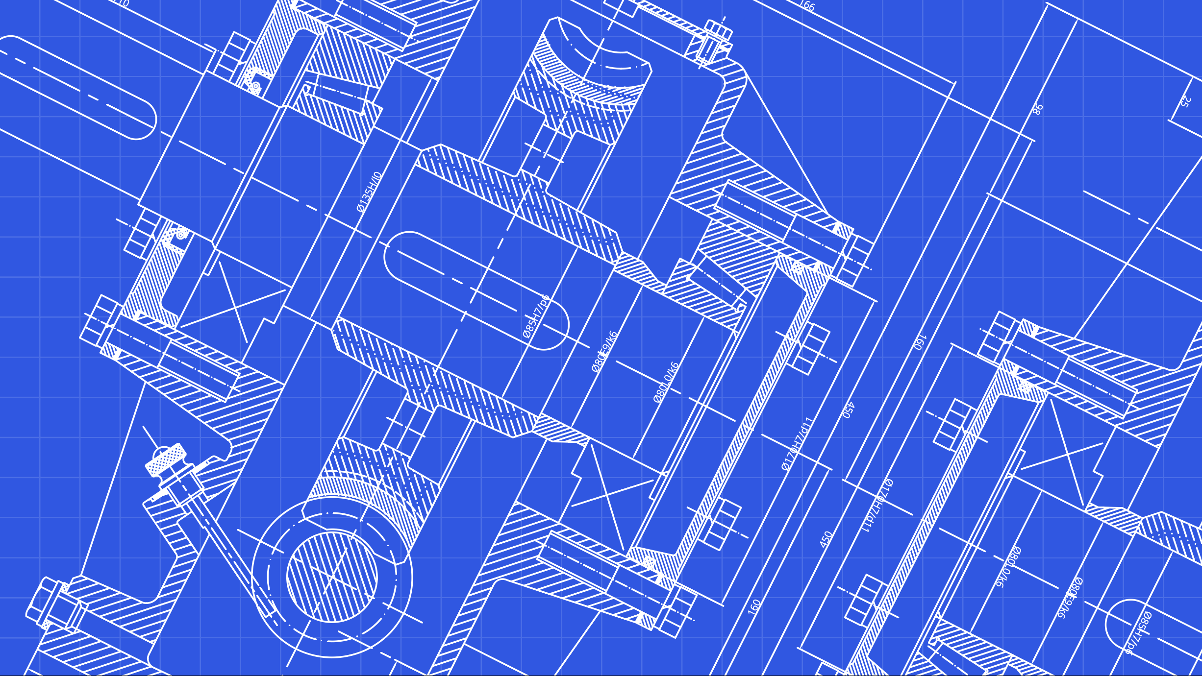
PROJECT MODULES
02
Explaining the project components, associations, Purpose and Blueprint

Slide 6
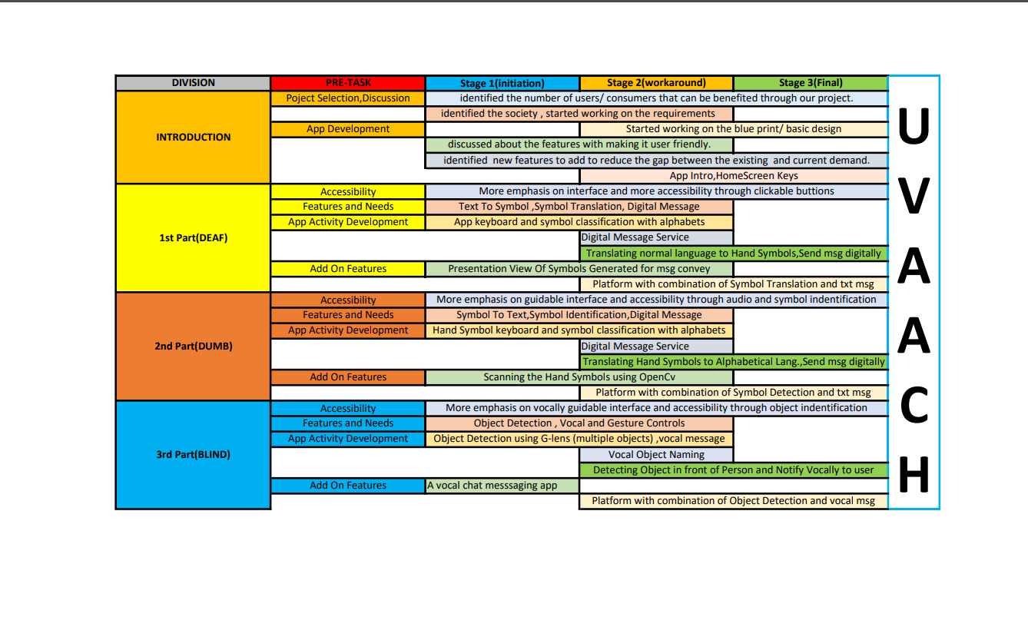
BLUEPRINT
BLUEPRINT

Slide 7
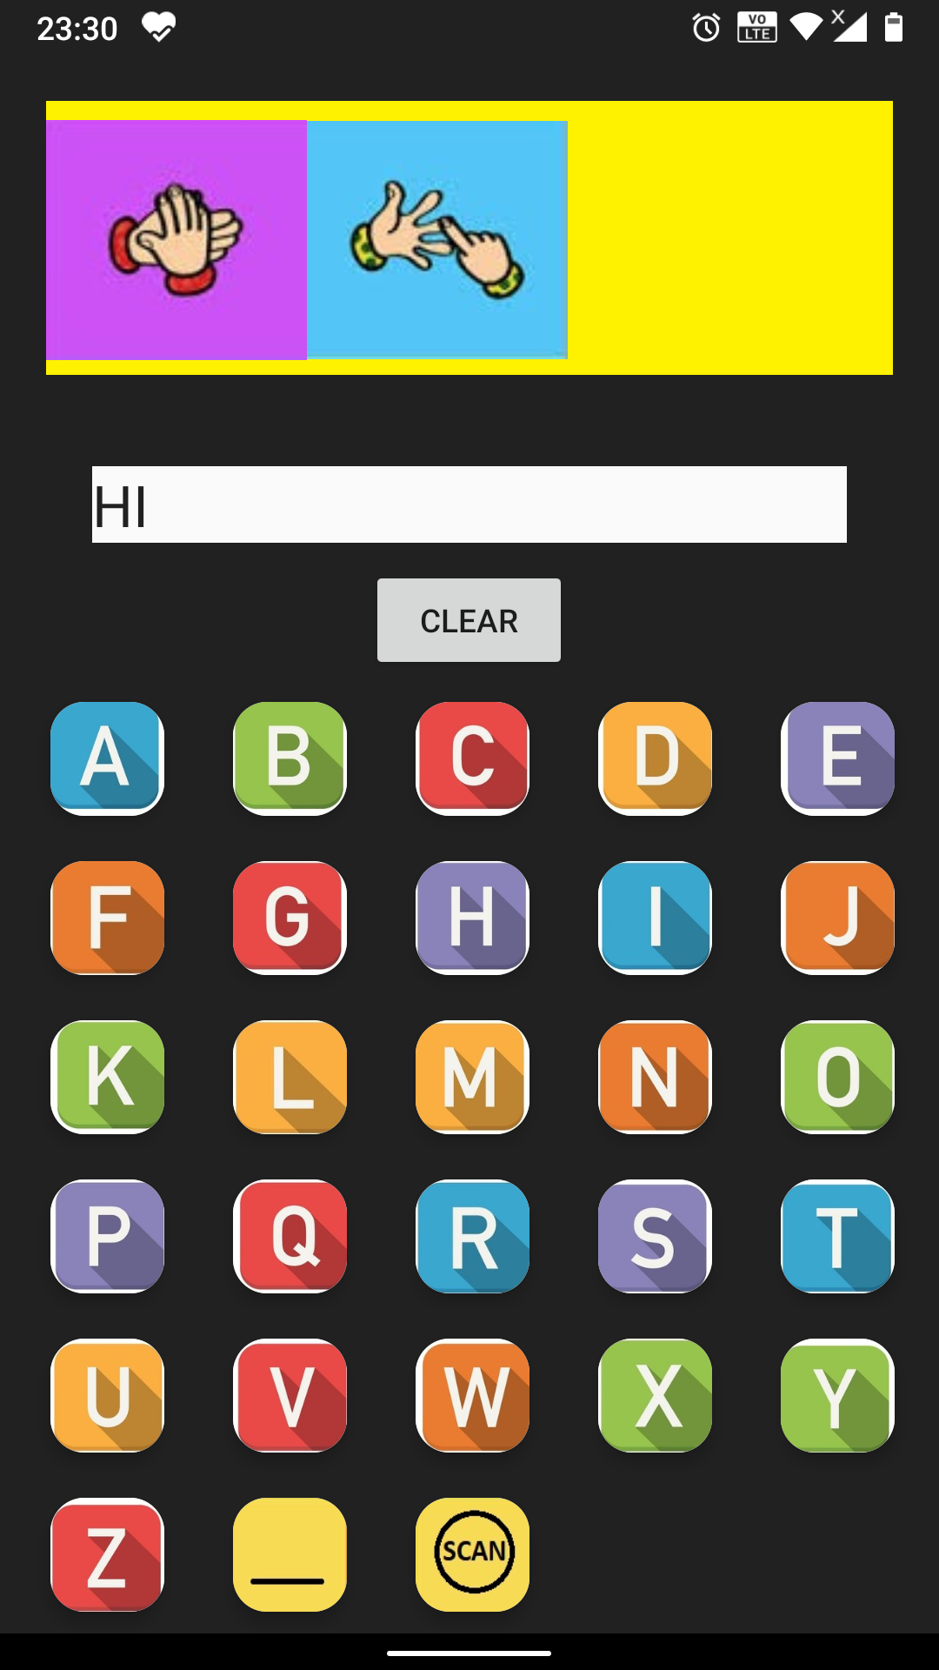
MODULE 1
Modules :
1. Deaf (For People who can’t hear)
1.1 Alphabet to Symbol keyboard
1.2 Scan Hand Symbol
1.3 Hand Symbol Model
1.4 Tensorflow Lite Object/Symbol Detection
1.5 Bluetooth Chat

Slide 8
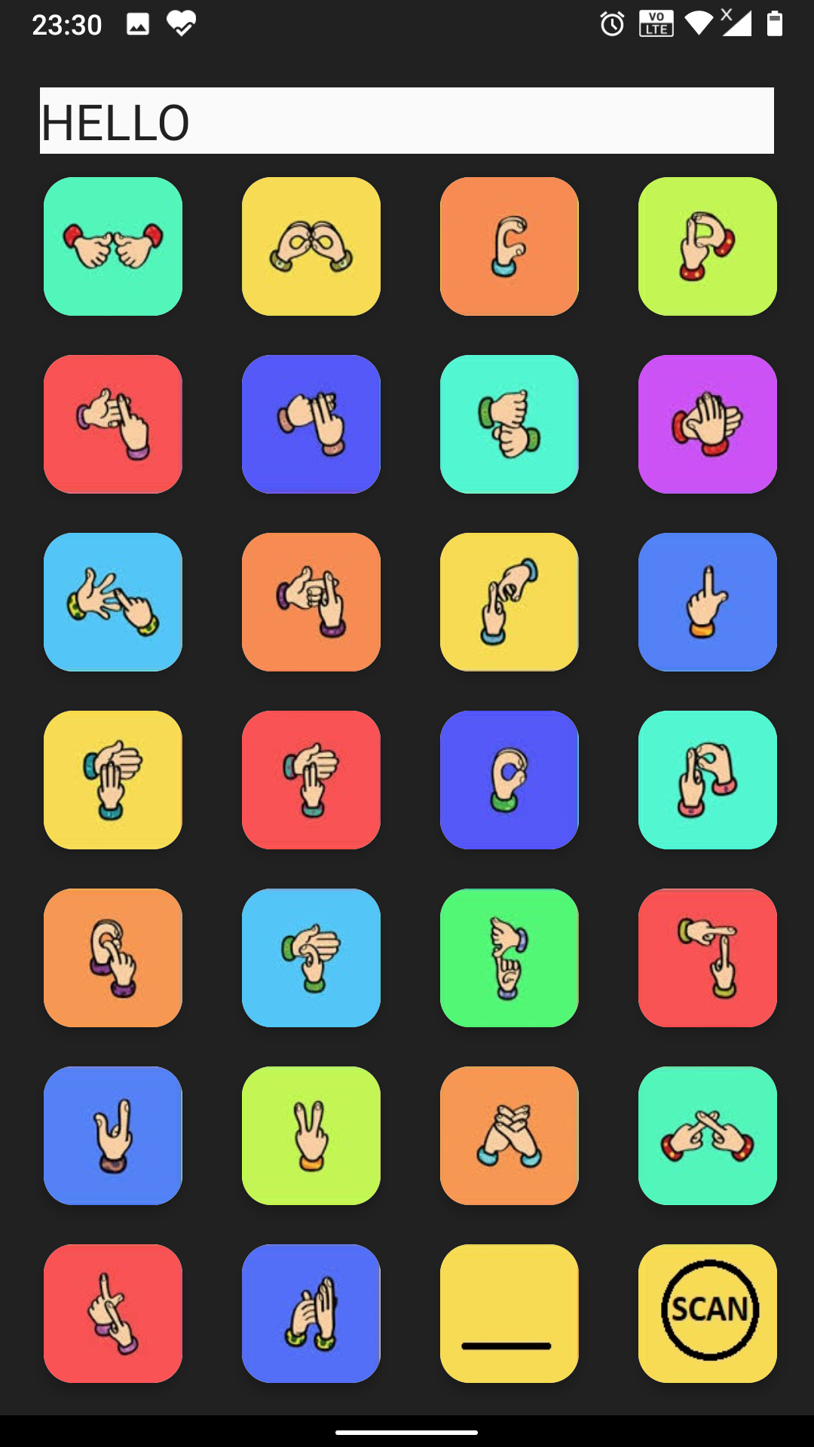
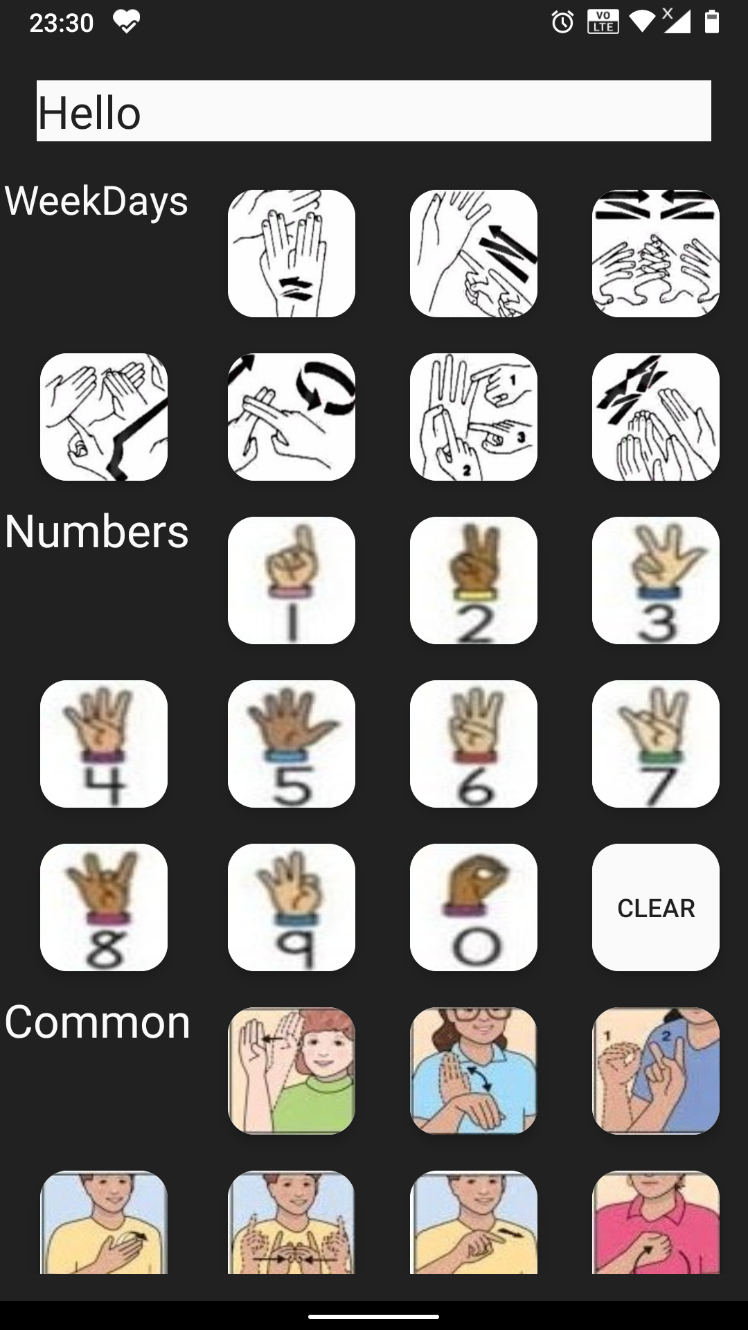
Modules:
2. Dumb (For People who can’t speak)
2.1 Symbol to Alphabet Keyboard
2.2 Weekdays, Numbers, Common Gestures Keyboard
2.3 Scan Hand Symbol
2.4 Hand Symbol Model
2.5 Tensorflow Lite Object/Symbol Detection
2.6 Bluetooth Chat

Slide 9
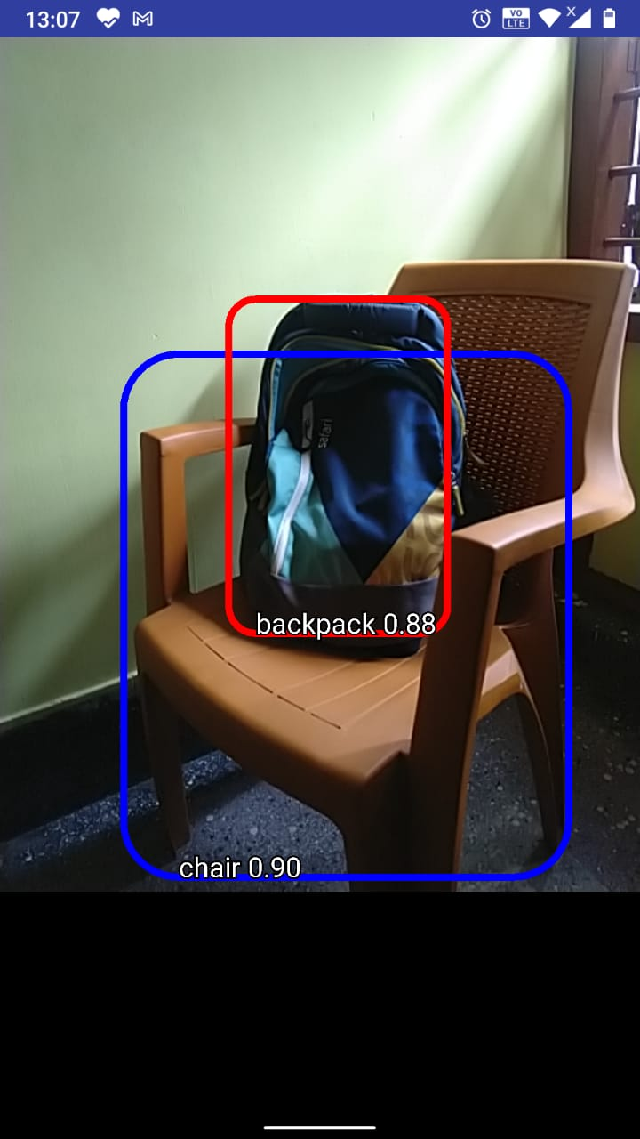
MODULE 3
Modules:
3. Blind (For People who cannot see)
3.1 Scanning objects in front of the user and notifying
3.2 Common Objects Model
3.3 Tensorflow Lite Object Detection
3.4 Google Text to Speech

Slide 10
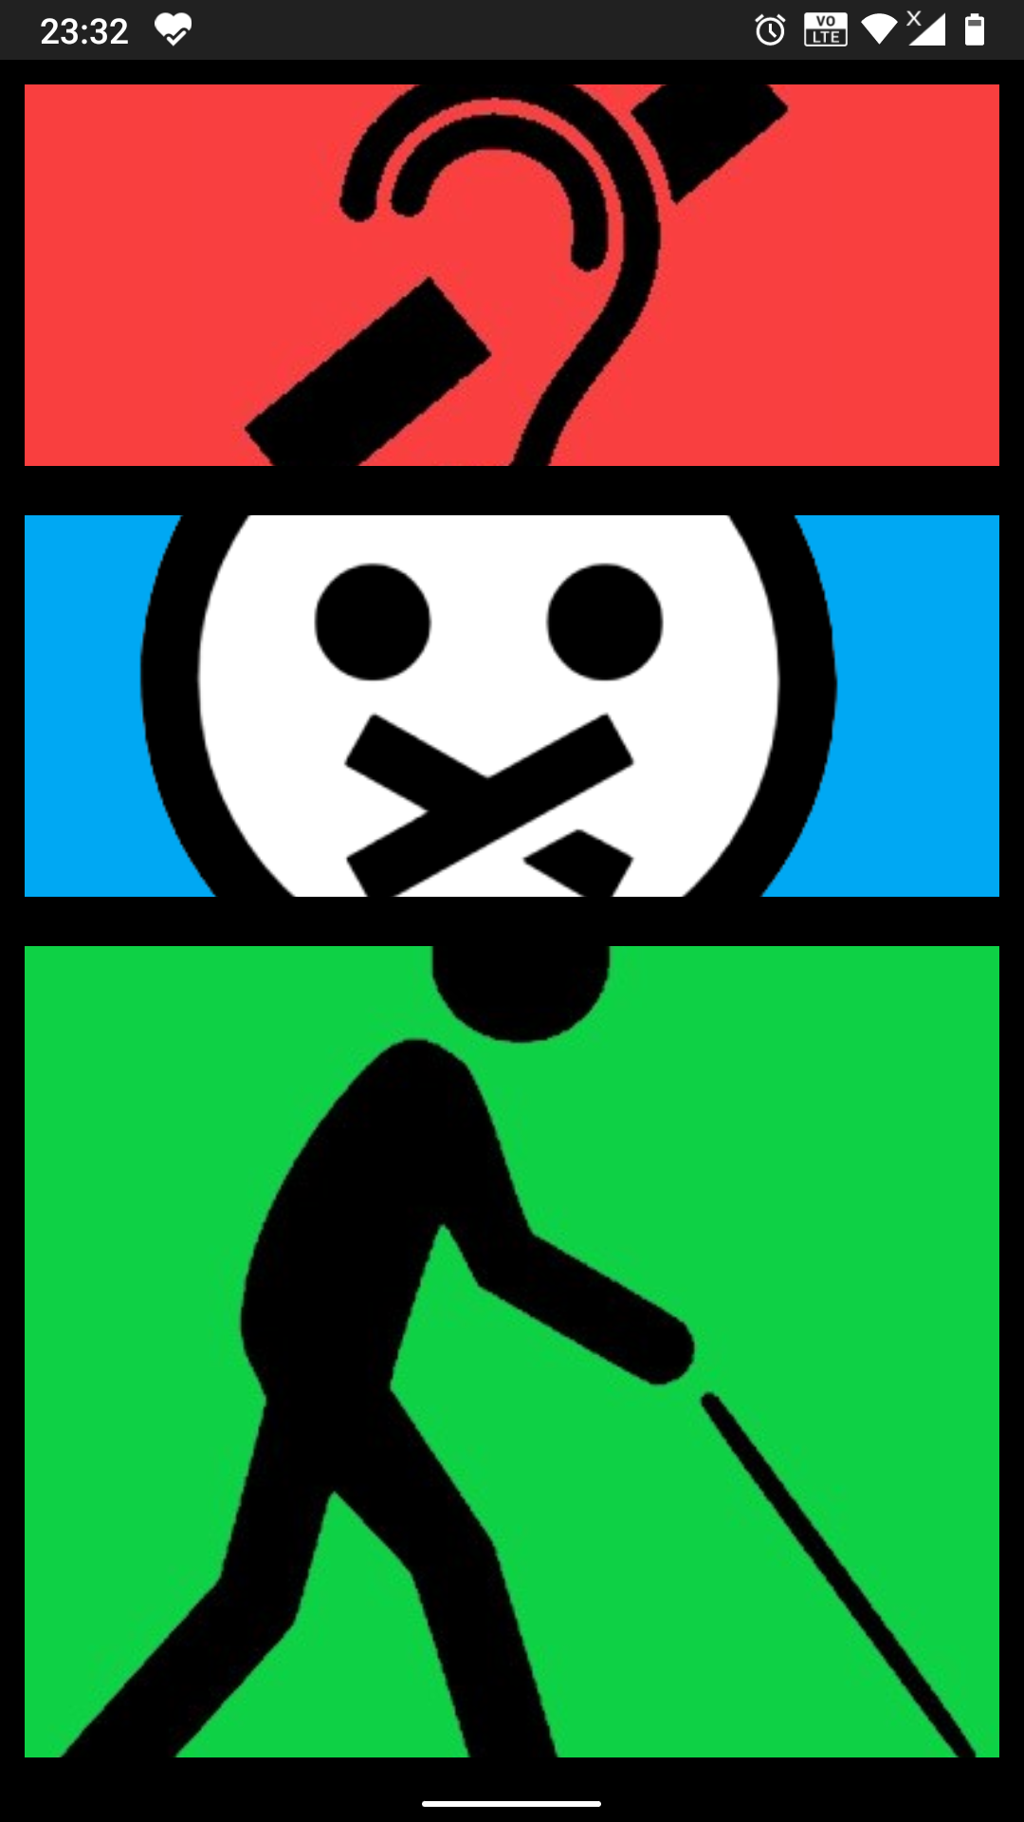
UVVACH
App Layout And Interface
Android Layout Types: There are number of Layouts provided by Android which we use in almost all the Android applications to provide a different view, look and feel. such as :
Linear Layout: LinearLayout is a view group that aligns all children in a single direction, vertically or horizontally.
Table Layout : TableLayout is a view that groups views into rows and columns.
Frame Layout : The FrameLayout is a placeholder on screen that you can use to display a single view.
List View : ListView is a view group that displays a list of scrollable items.
Grid View : GridView is a ViewGroup that displays items in a two-dimensional, scrollable grid.

Slide 11
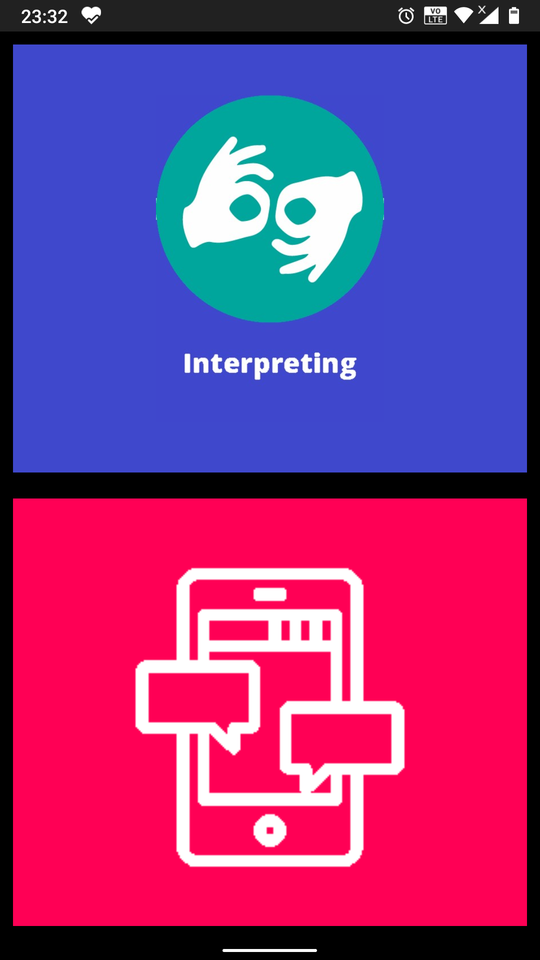
UVVACH
App Layout And Interface
Layout Attributes : Each layout has a set of attributes which define the visual properties of that layout. There are few common attributes among all the layouts and their are other attributes which are specific to that layout. Following are common attributes and which we applied to all the layouts:
android:id (This is the ID which uniquely identifies the view)
android:layout_width ( This is the width of the layout.)
android:layout_height(This is the height of the layout)
android:layout_marginTop(This is the extra space on the top side of the layout.)
android:layout_weight(This specifies how much of the extra space in the layout should be allocated to the View.)

Slide 12
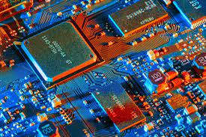
UVVACH
Technology Used
03

Slide 13
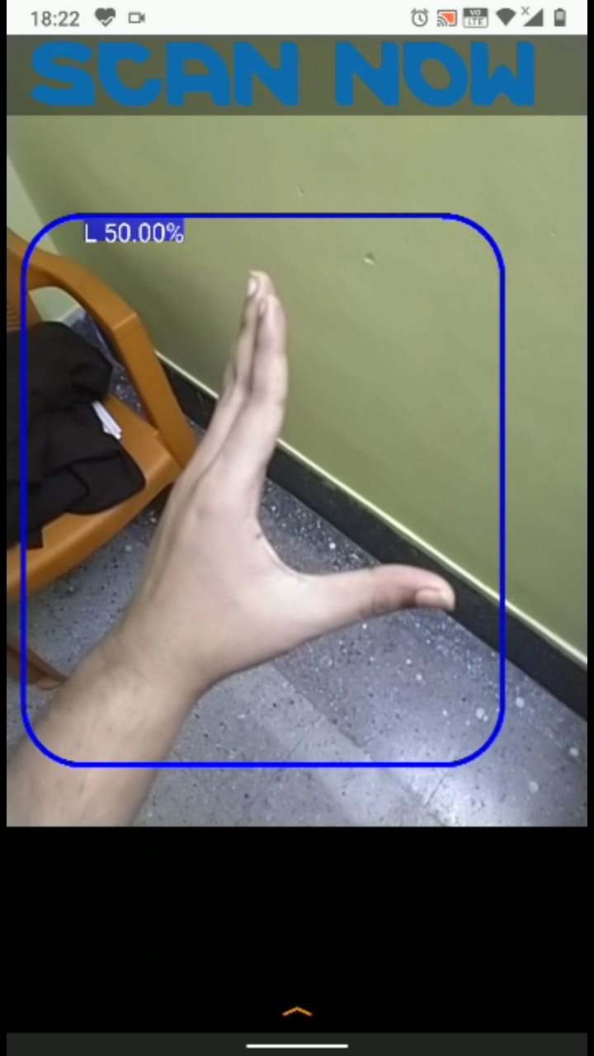
UVVACH
Scan Hand Symbol
Scan Hand Gestures : The goal is to detect and recognize various user-defined gestures. This technology can be a boon for disable people who are not able to speak and hence can’t communicate with people. A different database has been developed for multiple sign gestures using an Android Device. These gestures have been taken from the Indian Sign Languages that uses both hands. Gestures have been captured in black background with a single light source.

Slide 14
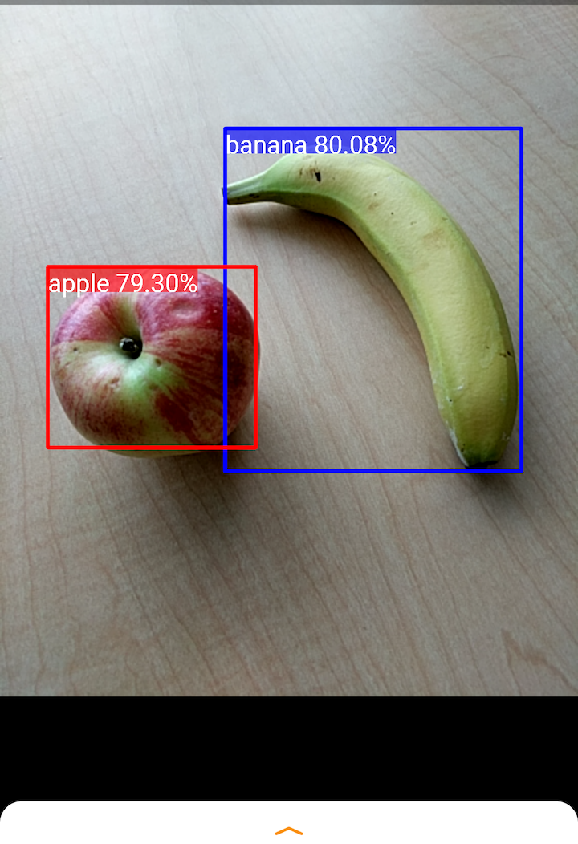
Tensorflow Lite Object / Symbol Detection
An Object Detection Model can identify which out of the known set of objects might be present and provide information about their positions within the image.
For example, this screenshot of the example application shows how two objects have been recognized and their positions annotated.

Slide 15
UVVACH
An Object Detection Model is trained to detect the presence and location of multiple classes of objects. For example, a model might be trained with images that contain various pieces of fruit, along with a label that specifies the class of fruit they represent and data specifying where each object appears in the image.
When an image is subsequently provided to the model, it will output a list of the objects it detects, the location of a bounding box that contains each object, and a score that indicates the confidence that detection was correct.

Slide 16
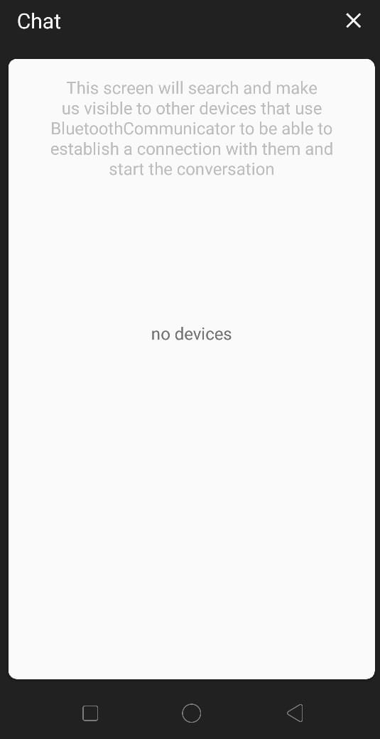
UVVACH
Bluetooth Chat
The Android platform includes support for the Bluetooth network stack, which allows a device to wirelessly exchange data with other Bluetooth devices. The app framework provides access to the Bluetooth functionality through Bluetooth APIs. These APIs let apps connect to other Bluetooth devices, enabling point-to-point and multipoint wireless features. This application allows two Android devices to carry out two-way text chat over Bluetooth. It demonstrates all the fundamental Bluetooth API capabilities, such as:
• Scanning for other Bluetooth devices
Querying the local Bluetooth adapter for paired Bluetooth device
Establishing RFCOMM channels/sockets
• Connecting to a remote device
Transferring data over Bluetooth

Slide 17
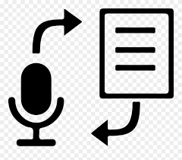
UVVACH
Google Text To Speech
Text-to-Speech allows to convert arbitrary strings, words, and sentences into the sound of a person speaking the same things.
Speech Synthesis: The process of translating text input into audio data is called synthesis and the output of synthesis is called synthetic speech. Text-to-Speech takes two types of input: raw text or SSML-formatted data. To create a new audio file, you call the synthesize endpoint of the API.
User Interface : The user interface is going to be simple — a LinearLayout as the root view group, inside which there will be a Button which launches the Speech Recognition API, an EditText that shows the Speech Recognition output as well as serves as input to Text-to-speech functionality, and another Button to trigger Text-to-speech output.

Slide 18
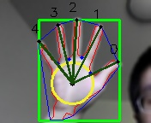
UVVACH
Hand Symbol Model :
The goal is to detect and recognize user-defined gestures using the camera of an Android phone. A demo Android app that lets the user launch other applications using gestures is developed to show the real time performance.
The green box represents the bounding box of the hand. The blue line represents the convex hull. The red line is the contour of the hand. The green dots between the fingers are defect points. The yellow circle is the inscribed circle and the black dot is the center of the circle, which is treated as the center of the palm. The dark green lines are finger vectors, and the order is indicted by the numbers

Slide 19

Responsibility of each team member
04
The timeline of the project schedule. Week-wise/Month-wise – the work plan

Slide 20
UVVACH
RESPONSIBILITY
Krish Gupta (18BCE10143):
Worked on the Symbol Keyboard,
He created various Keyboard Layouts for the Dumb and Deaf, where the Dumb’s Keyboard Layout consisted of hand symbols and common hand gestures, which when clicked showed the meaning of the symbol accordingly and the Deaf’s Keyboard Layout which consisted of normal alphabetical letters so as to take input and show symbols that you would have to do to communicate with the Deaf.
Chitwan Singh (18BCE10085):
Worked on Symbol Scanning,
He made a Hand Symbol TensorFlow Lite model after collecting all information for hand symbols, then used the same model in TensorFlow Lite Android Platform for identifying hand symbols. He assigned each hand symbol according to their meaning and made it such that it shows the meaning when detected. He also implemented common weekdays and digit symbol buttons in the Keyboard Layout.
Kartikey Naraiyan Garg (18BCE10140)
Worked on the App Layout and Interface,
He created the entire User Interface of the application with the layout for the three modes I.e. dumb, deaf and blind. He added an in-built audio for easy accessibility for the blind who would be using the app. He designed the layout for the keyboard for the respective modes and decided how it will be for each mode. He also designed the Bluetooth layout and kept it simple for easy access and usage.
Yashraj Anand (18BCE10326)
Worked on TensorFlow Lite Object Model.
He made the object model for TensorFlow Lite which was a collection of all common objects pictures with correct labelling for easy object detection. It was modified by him, time to time for better detection ability.
Kunal Verma (18BCE10150)
Worked on Object Detection,
He worked on Object Detection which was done on basis of scanning through camera view and identifying all objects per frame. The Object Model made was used in TensorFlow Lite Android Platform for detection through the use of mobile.
final prepared data was used to create the model accordingly.

Slide 21
UVVACH
RESPONSIBILITY
Dushyant Sengupta (18BCG10042)
Worked on Bluetooth Chat,
He implemented Bluetooth Chat for the Dumb and Deaf as both of them can see and touch. He followed simple Global Bluetooth Connection rules for easy and fast connection between the devices. The connection between the two devices was made easy just by keeping the Bluetooth section open on both client devices and anyone can request the other for connection. He kept the connection distance same as it was for standard bluetooth connection.
Soumya Tiwari (18BCY10100)
Worked on Google Text to Speech,
She integrated Google’s service after going through many text-to-speech available but afterwards finalizing Google. It was used for easy compatibility and smooth usage and also because it was observed to be fully compatible with TensorFlow Lite Android Platform. She developed so that it was used in real time in the blind section object detection.
Monisha Biswas (18BOE10033)
Worked on Hand Symbol Model Data Identification
Being in the Bio branch, she helped in gathering all hand gestures and symbols used by the community. She collected the information and divided it well into sub-sections according to usage and labelled it appropriately. The final prepared data was used to create the model accordingly.

Slide 22
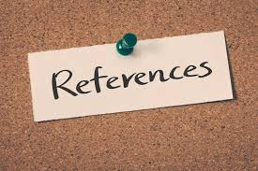
REFERENCES
05

Slide 23
RESOURCES
1. Asha G. Hagargund, Sharsha Vanria Thota, Mitadru Bera, Eram Fatima Shaik, “Image to Speech Conversion for Visually Impaired”, International Journal of Latest Research in Engineering and Technology, Volume 03, Issue 06, June 2017.
2. Chucai Yi, Student Member, IEEE , Yingli Tian, Senior Member, IEEE , and Aries Arditi “Portable Camera-Based Assistive Text and Product Label Reading From Hand-Held Objects for Blind Persons” 2013 IEEE.
3. K. Lakshmi, Mr. T. Chandra Sekhar Rao, “ Design and Implantation Of Text To Speech Conversion Using Raspberry PI”, International Journal of Innovative Technology and Research, Volume No. 4, Issue No. 6, October-November, 2016.
4. Martin Goldberg CUNY Graduate Center New York, NY. USA for “Assisting Visually Impaired People with Mobility through Technology in the Age of Context” in 2015.
5. Nagaraja L., Nagarjun RS, Nishanth M Anand, Nithin D, Veena S Murthy, “Vision based Text Recognition using Raspberry Pi”, International Journal of Computer Applications, National Conference on Power Systems & Indutrial Automation.
6. Pankaj Pathak Dept. of CSE Shri Vaishnav Institute of Computer science Indore, India,” Speech Recognition Technology: Applications & Future,” International Journal of Advanced Research in Computer Science Vol. 1, No.4, Nov-Dec 2012.
7. Rithika H., B. Nithya Santhoshi, “Image Text To Speech Conversion In The Desired Language By Translating With Raspberry Pi”.
8. S.B.Shroke, Nandar Dehpande, Prashant Deshmukh, Sanjay Kumar Mathapati. ”Assistive Transulator For Deaf And Dumb People”-in July-2014.

Slide 24
UVVACH
RESOURCES
9. Shraddha R. Ghorpade, Surendra K. Waghamare, “Full Duplex Communication System for Deaf & Dumb People,” International Journal of Emerging Technology and Advanced Engineering (IJETAE), Volume 5, Issue 5, May 2015, ISSN 2250-2459.
10. Shwan Hadi and Oğuzhan Özdemir for “Development of Learning Software for Deaf: A Sample of Language Learning Material” Software Engineering Department,College of Technology, Computer Education and Instructional Technology Department, College of Education, Firat University, Elazig, Turkey Vol. 6 Issue 06, June – 2017.

Slide 25
Thank you!

